Slide 1
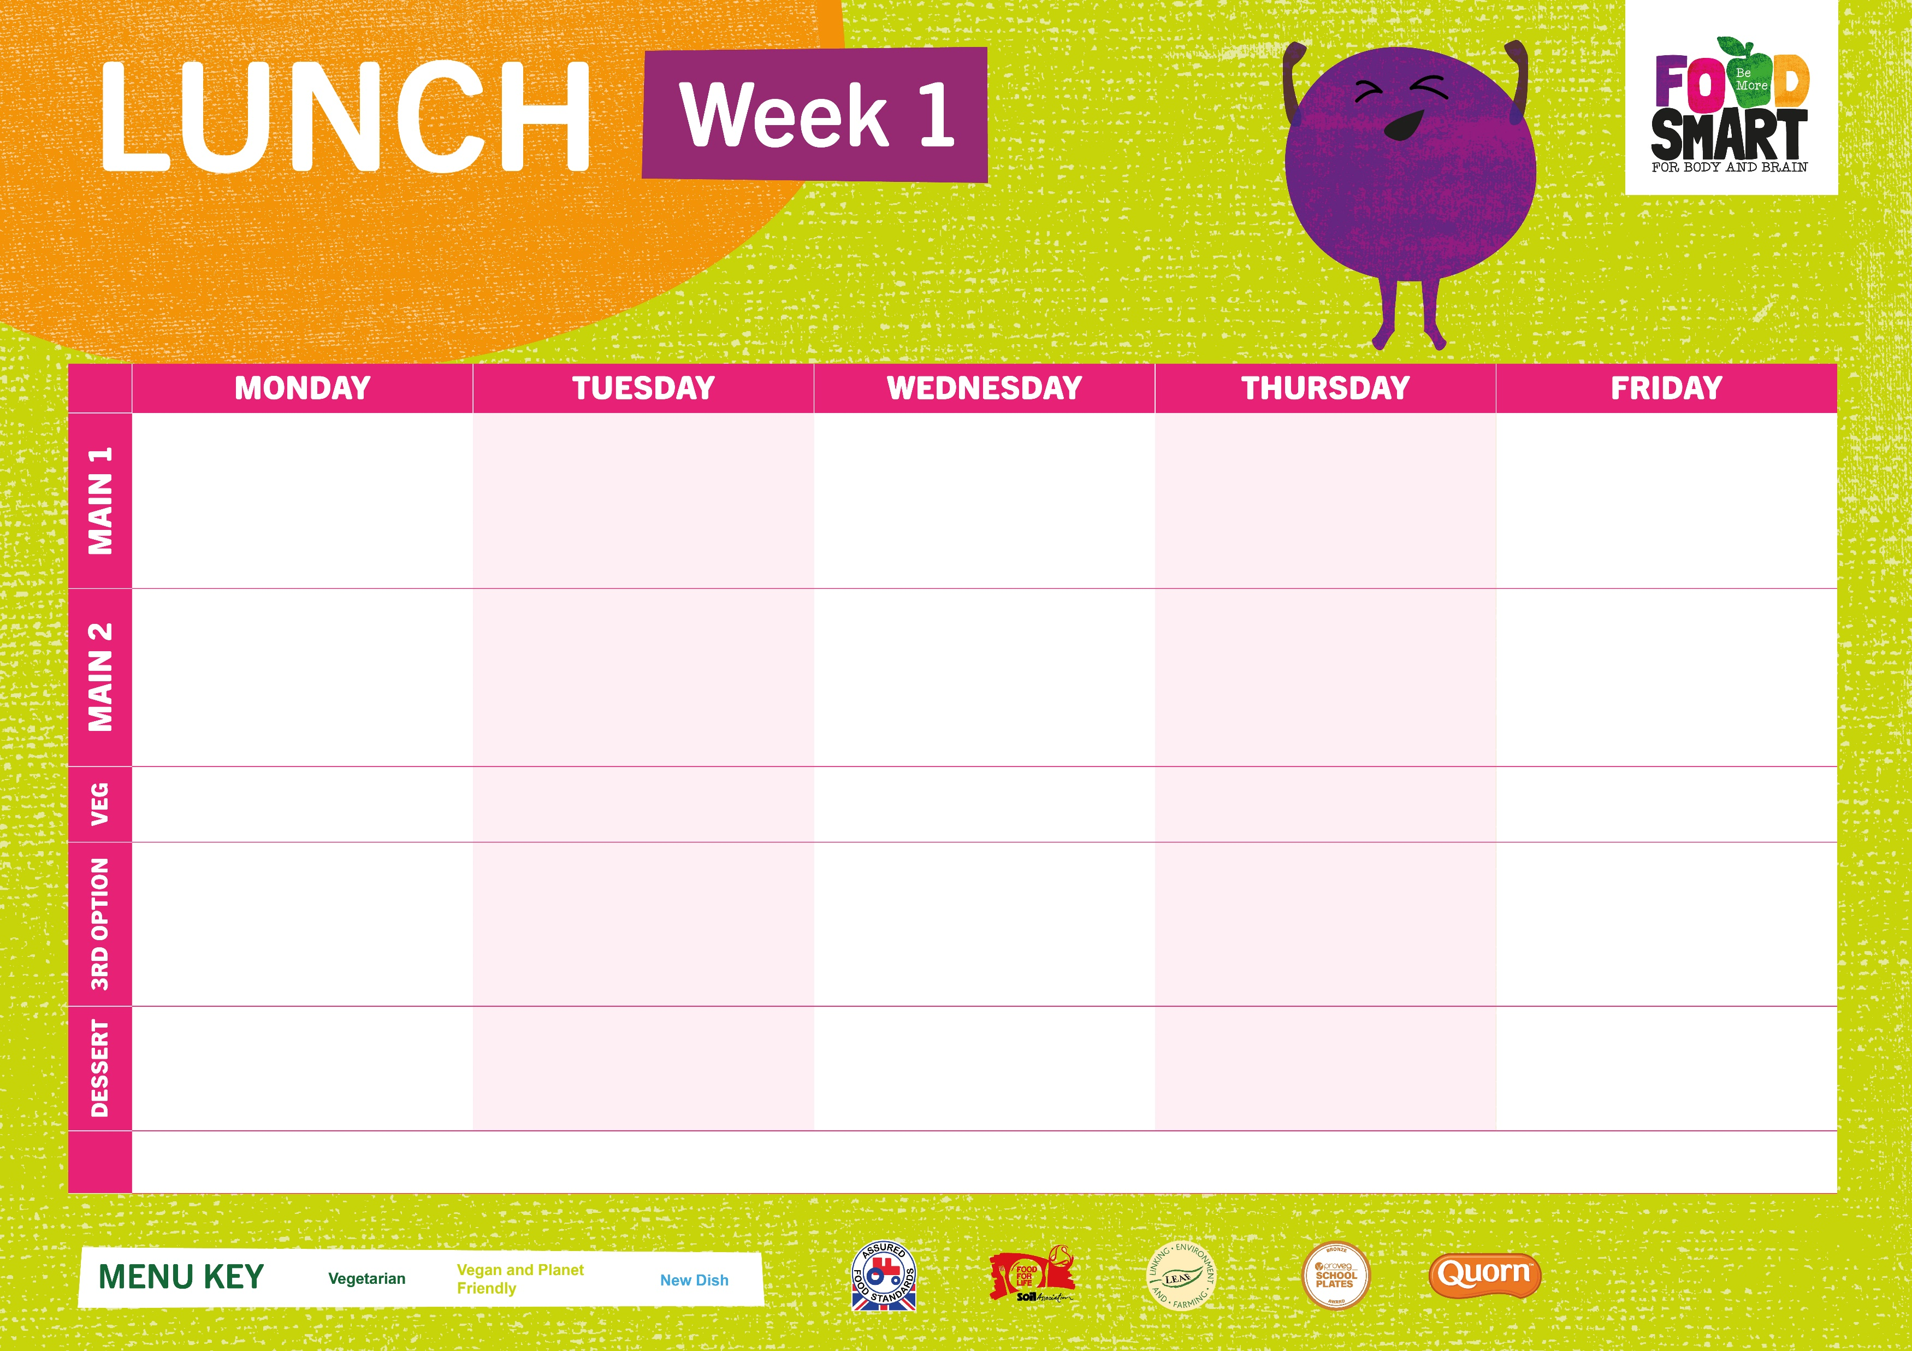
W/C 3rd Nov, 24th Nov, 15th Dec, 5th Jan, 26th Jan
^{Cheese & Tomato Pizza V} | Halal Southern Baked Chicken & Wedges Southern Baked Chicken & Wedges | Roast Chicken, Halal Roast Chicken with Roast Potatoes | Pasta Bolognese, Halal Pasta Bolognese – Garlic Bread | ^{Fish Fingers with Chips}
^{Farmhouse Hash VE} | ^{Chilli Bean Wrap, Wedges V} | ^{Quorn Roast, Roast Potatoes V} | ^{Creamy Mac & Cheese V} | Crispy Quorn Nuggets & Chips VE
^{Garlic Bread & Sweetcorn} | ^{Fresh Broccoli} | ^{Carrots & Cabbage} | ^{Green Beans} | ^{Carrots & Peas & Baked Beans}
Tomato Pasta or Filled Deli Sandwiches | Jacket Potatoes – Choice of Cheese, Beans or Tuna or Filled Deli Wraps | Tomato Pasta or Filled Deli Sandwiches | Jacket Potatoes – Choice of Cheese, Beans or Tuna, Filled Deli Wraps | Tomato Pasta or Filled Deli Sandwiches
Freshly Baked Chocolate Cookie VE | ^{Carrot Cake VE} | ^{Pear Upside- Down} ^{Pudding V} | ^{Fruity Jelly Pot VE} | ^{Coconut Cake VE}
Fruit & Yoghurt
V
VE
N

Slide 2

W/C 10th Nov 1st Dec 22nd Dec 12th Jan 27th 2nd Feb
^{Mac n Cheese V} | Chicken Burger & Wedges, Halal Chicken Burger & Wedges | Roast Chicken / Halal Roast Chicken & Roast Potatoes Roast Potatoes | Sausage Penne Pasta Bake or Halal Chicken Sausage Penne Pasta Bake | ^{Battered Fish & Chips}
Roasted Tomato & Basil Pasta VE | ^{Bean Chilli Wrap & Wedges VE} | ^{Vegetable Patty V} | ^{Veggie Sausage Pasta Bake VE} | Breakfast Wrap Cheese and Beans & Chips VE
^{Garlic Bread & Peas} | ^{Sweetcorn} | ^{Fresh Roast Carrots & Swede} | ^{Garlic Bread & Broccoli} | ^{Carrots & Peas or Baked Beans}
Jacket Potatoes – Choice of Cheese, Beans or Tuna or Deli Filled Wraps | Tomato Pasta or Deli Filled Sandwiches | Jacket Potatoes – Choice of Cheese, Beans or Tuna or Deli Filled Wraps | Tomato Pasta or Deli Filled Sandwiches | Jacket Potatoes – Choice of Cheese, Beans or Tuna or Deli Filled Wraps
^{Chocolate Cornflake Cake VE} | ^{Oaty Lemon Cookie} | ^{Ginger Cake VE} | ^{Vanilla Cookie} | ^{Berry Crumble Tray Bake V}
Fruit & Yoghurt
V
VE
N

Slide 3

W/C 17th Nov 8th Dec 6th 29th Dec 19th Jan 9th Feb 10th
^{Cheese & Tomato Pizza V} | BBQ Chicken /or Halal BBQ Chicken & Rice | Roast Chicken, Halal Roast Chicken & Roast Potatoes | Traditional Lasagne or Halal Lasagne | ^{Fish Fingers & Chips}
^{Korean Baked Cauliflower VE} | Chickpea & Spinach Curry, Rice V | Golden Sausage Roll VE & Roast Potatoes | Spaghetti & Veggie Meatballs VE | ^{Veggie Hot Dog & Chips VE}
^{Wedges & Sweetcorn} | ^{Garden Peas} | ^{Savoy Cabbage & Roasted Squash} | ^{Focaccia & Green Beans} | ^{Carrots & Peas or Baked Beans}
Tomato Pasta or Deli Filled Sandwiches | Jacket Potatoes – Choice of Cheese, Beans or Tuna or Deli Filled Wraps | Tomato Pasta or Deli Filled Sandwiches | Jacket Potatoes – Choice of Cheese, Beans or Tuna or Deli Filled Wraps | Tomato Pasta or Deli Filled Sandwiches
^{Apple & Cinnamon Flapjack VE} | ^{Chocolate Mousse V N} | Pear & Ginger Cake VE & Custard | ^{Chocolate Oaty Flapjack V} | ^{Freshly Baked Vanilla} ^{Cookie VE}
Fruit & Yoghurt
V
VE
N

