Slide 1

Anxiety
Aim of the session:
What is anxiety, what does it look like
Quick overview of how stress and anxiety impact our rational brain and working memory.
Discuss ways we can work through anxiety

Slide 2
Anxiety
The Flight, Fight or Freeze response.
Historically, it’s our brains alarm system to keep us alive.
Now we have less predators, it is less helpful!
NHS: Anxiety is a feeling of unease, such as worry or fear, that can be mild or severe.

Slide 3
Anxiety is…
A natural response to pressure, feeling afraid or threatened.
This is in turn can impact how we feel mentally and physically, as well as how we behave.
Becomes an issue when it becomes overwhelming
Many describe it as a feeling of dread, fear or unease, which can range from mild to severe.

Slide 4
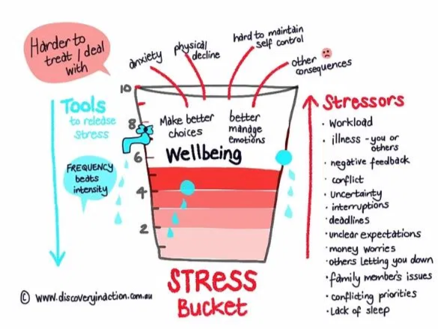
When it becomes too much…
Anxiety can become a problem if we start worrying a lot about small stuff or relatively harmless situations.
It’s usually when our anxiety feels really intense or overwhelming that it starts to interfere with our daily life or affect our relationships.
It is important to be mindful of your own stress levels as well.
It is hard to co-regulate when you are dysregulated.

Slide 5


So what does anxiety look like?
Tummy ache, feeling sick,
Being irritable, tearful or clingy,
Waking in the night, having bad dreams, wetting the bed,
Find it hard to concentrate,
Have problems sleeping or eating,
Avoid every day activities including seeing friends or going to school,
Feeling of a tight chest
Perfectionism
Avoidance
Those with anxiety can be highly sensitive. They take in more about facial expressions, for example a student with anxiety may interpret a teacher’s face negatively and become anxious about it.
They can also be empathetic.

Slide 6
Impact of Anxiety on working memory
Studies show that when people experience high levels of anxiety, their working memory capacity suffers.
Said to be because more cognitive energy is expended in managing the anxiety.
Persistent cortisol from anxiety can impair memory and cognitive function.
When we feel stressed/anxious and overwhelmed, our emotional brain kicks in. (Trolley dilemma).
Things we can do to switch our rational brain in to gear:
Research shows that a cold sensation can switch the brain from the emotional brain to the rational brain. This could be holding an ice cube (not for very long!) or simply splashing your face with some cold water.
Counting back in 6s from 100 can overload the emotional brain, helping it to switch the irrational brain.

Slide 7
What can we do about it?
Be curious. Notice, describe and wonder aloud – “it seems like it’s really important for you to feel like you’re in control of things right now, I’m wondering why that might be?” or “I notice you’re finding it hard to stay focused right now, I am wondering if there might be something on your mind?”.
Awareness, Acceptance, Act :
  Awareness: giving them awareness, they may not know why the anxiety is happening but you can help them become aware of the physical signs.
  Acceptance: breaking that negative cycle, help them to accept that they feel nervous. You don’t have to like it, just have to accept it. Use a timer 1-2 minutes for them to say everything they’re anxious about.
  Act: What can we do to manage it? E.g sharing first in a group. What can they do to control the situation/anxiety.
Visualisation: visualise yourself doing the thing that makes you anxious. Work through it in as much detail as you can. It helps the brain feel as though it has done it before so it become manageable

Slide 8
Use of ground techniques: the 5 Senses. What can you hear? See? Smell? Taste? Feel? Or use the rule of 3 – 3 things you can, 3 sounds you can hear and move 3 body parts.
Work through the worst case scenario (when catastrophising) – what would that be? What would you do?
Power posing: research shows that holding the power pose for 20 + secs can help you feel more successful
Biting a pencil: a bit more abstract but research based, biting a pencil can force your facial muscles in to a smile and can help switch the brain pattern.
Yes but…change the ‘but’ to ‘and’. Yes and I will get through it.
Using your own voice: research shows saying your name and advice out loud is more effective than your inner monologue
Know that whatever you decide, they will follow: do you believe they are safe at school/gym/club? Then the children will follow.

Slide 9
When to seek help and how…
Week 4
Talk
Speak with the child’s teacher or school SENCO to share observations.
Week 1-3
Notice
If anxiety lasts several weeks and affects school, sleep, or relationships, it’s time to act.
Week 5+
Refer
This may be to the School Nurse, GP or CAMHS.

Slide 10
Any questions?

Slide 11
Resources
HeySigmund (NZ based) website with some useful articles
Books:
  Ruby’s Worry
  No Worries! Mindful kids Activity book
  Starting the Anxiety Gremlin
  Don’t Worry, Be Happy: A child’s Guide to overcoming Anxiety
  The Happy Self Journal

