Slide 1


January 2021
How to stay safe near the roads in winter

Slide 2
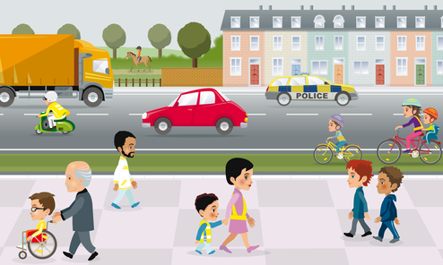
How do you stay safe near the roads?

Slide 3
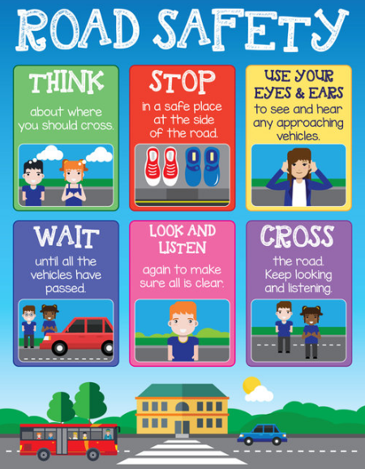
Click the link to listen to the song about crossing the road safely
'Safe cross code' song

Slide 4

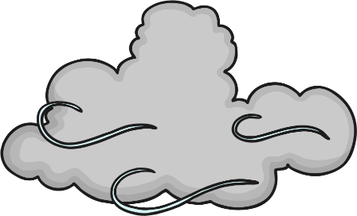

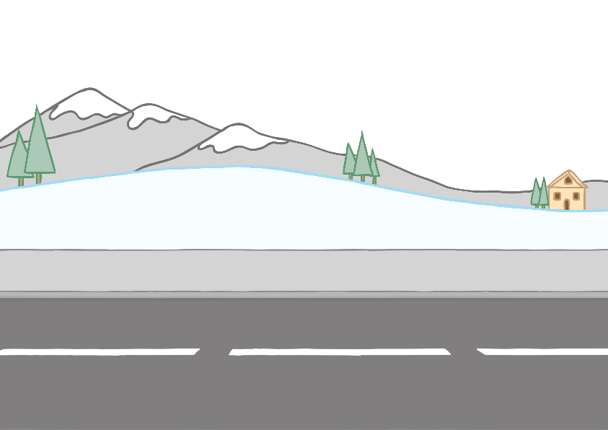
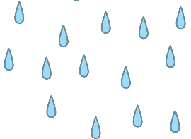
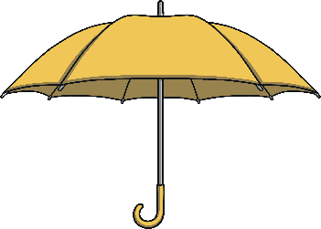
Road Safety in Winter
Why do you have to be extra careful when out walking near roads in the winter?
weather
dark mornings and nights

Slide 5
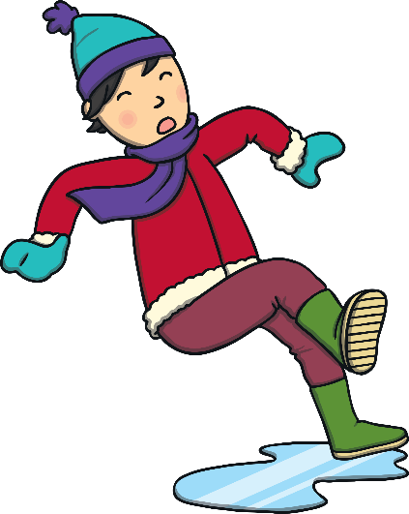
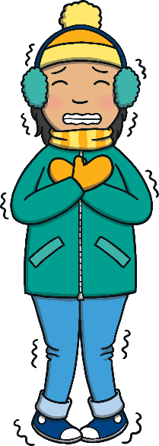
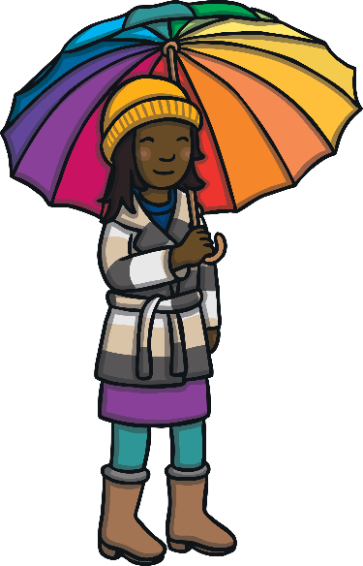
Weather
The weather can make it dangerous to cross the road.
Pavements around the roads might be slippery. It is important to wear shoes with grips.
People wear hats to keep them cosy and this can stop them from hearing the traffic.
If it is raining or snowing, people use umbrellas or put up their hoods to keep dry. This can block their view.

Slide 6
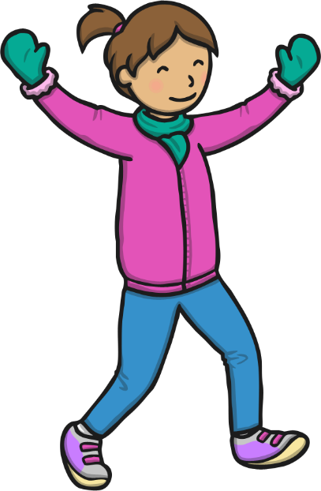
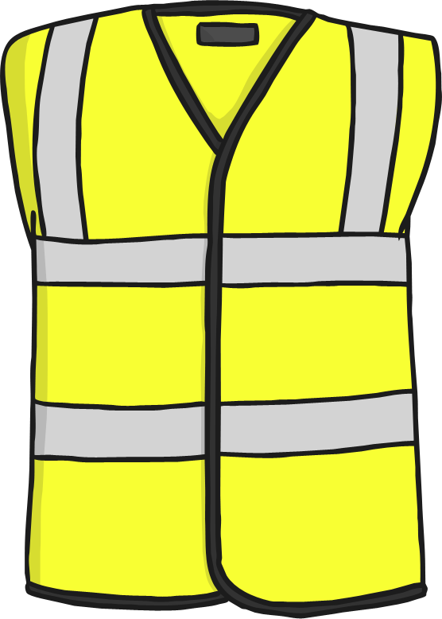
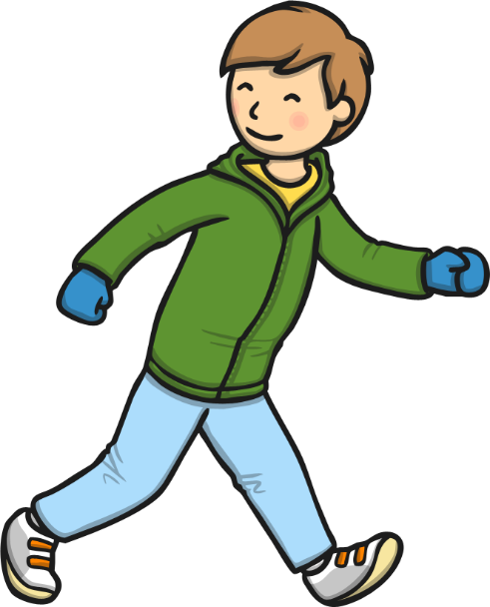
Be Bright, Be Seen
Why are bright clothes and reflective clothing important in the winter?
wear bright clothes
wear reflective clothing

Slide 7


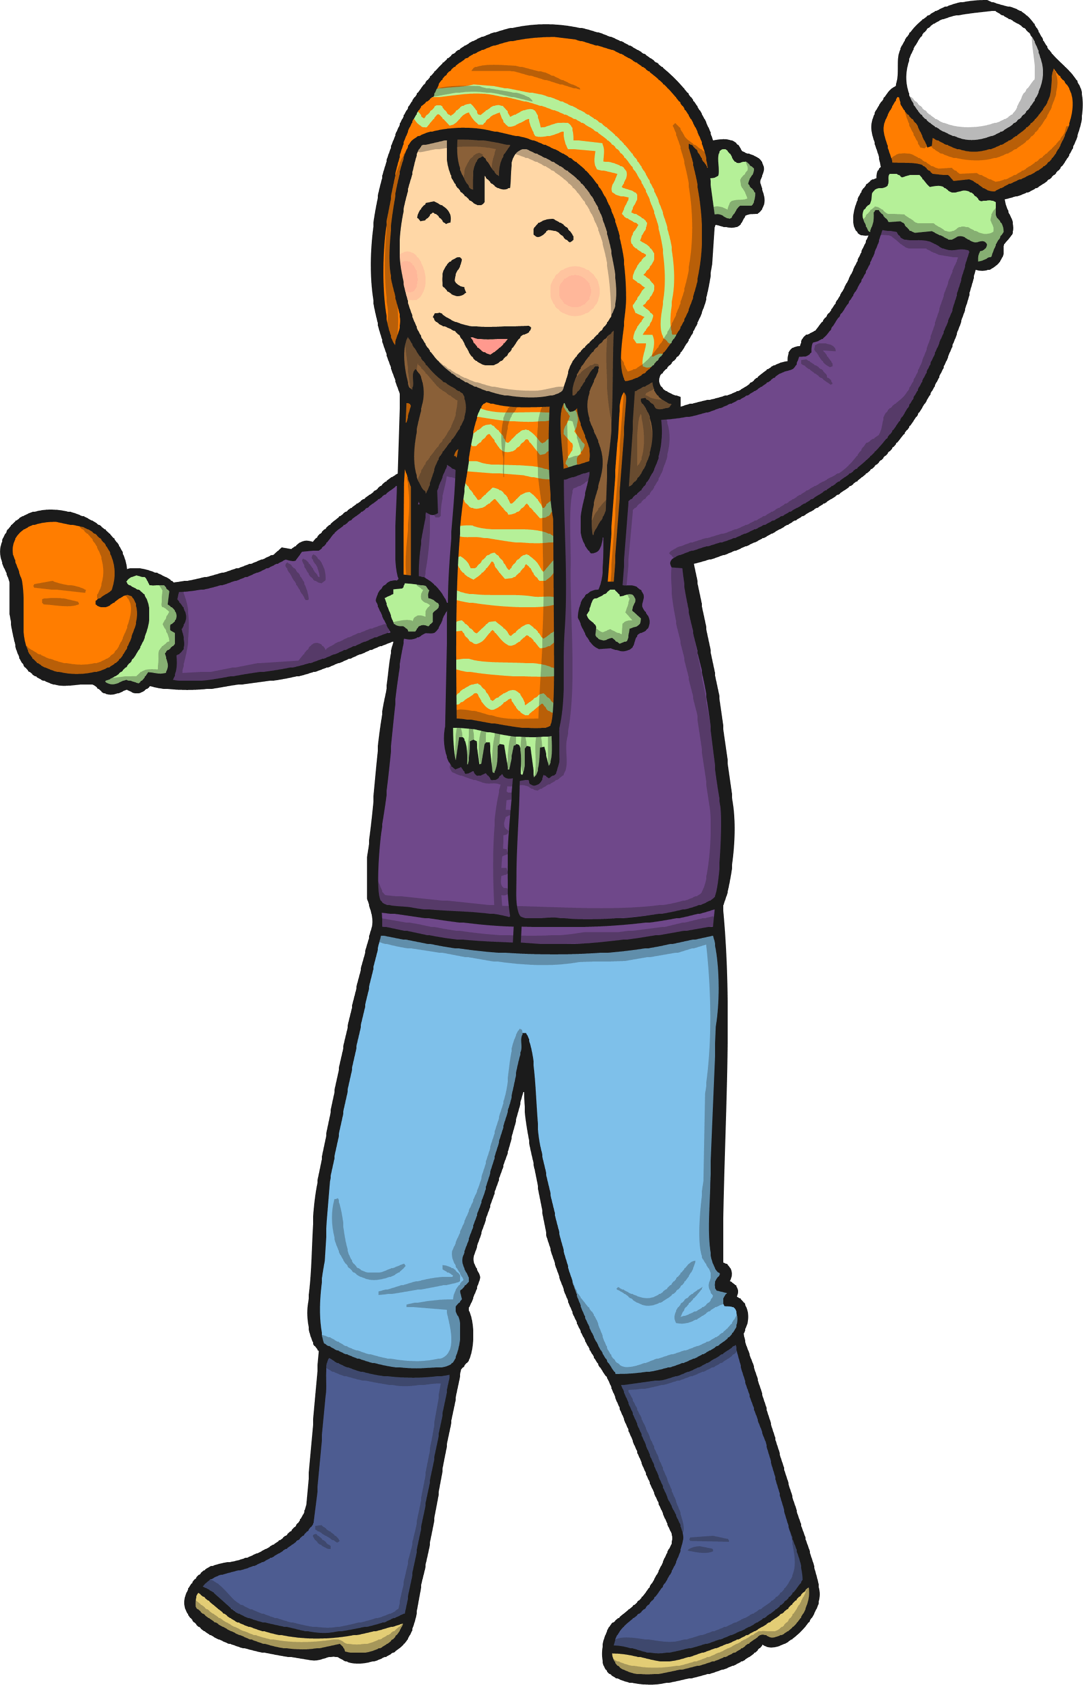
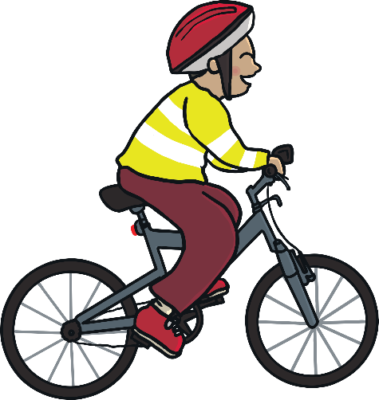
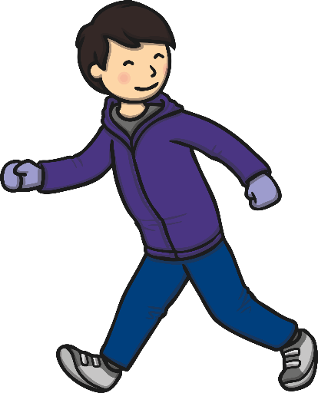
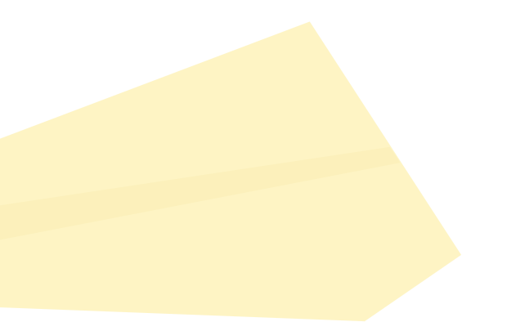
Be Bright, Be Seen
Reflective materials glow brightly when light shines onto them.
Fluorescent clothes show up well during the day and at dusk.

Slide 8




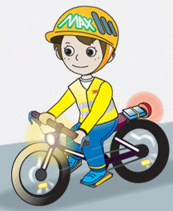
Be Bright, Be Seen
To keep safe in the dark, it is a good idea to wear
clothes that are reflective and fluorescent.
Can you think of anyone who wears fluorescent and reflective clothing?

Slide 9
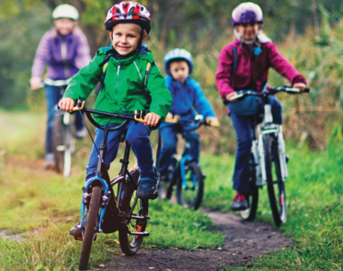
When should I start to cycle?

Slide 10
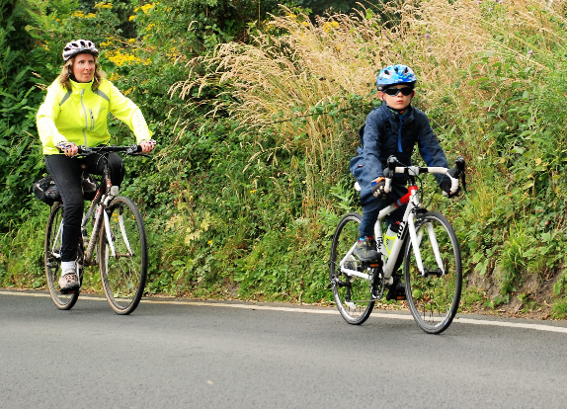
When should I start to cycle?

Slide 11
Cycling on the roads
Click the link below to watch a video about cycling on the roads before taking the quiz on the next few pages.
We love to cycle!

Slide 12
Q1
Name two things that make crossing
the road dangerous in winter.

Slide 13



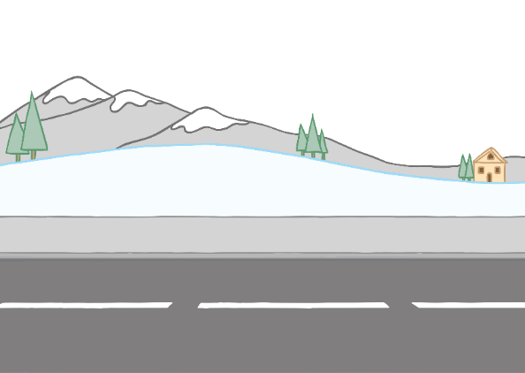
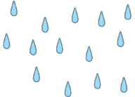
Q1
Name two things that make crossing
the road dangerous in winter.
weather
dark mornings
and nights

Slide 14
Q2
Where is a safe place to cross the road?
a. next to a
parked car
a. next to a
parked car
b. near a
roundabout
b. near a
roundabout
c. on a bend
c. on a bend
d. at a zebra
crossing
d. at a zebra
crossing

Slide 15
Q2
Where is a safe place to cross the road?
a. next to a
parked car
a. next to a
parked car
b. near a
roundabout
b. near a
roundabout
c. on a bend
c. on a bend
d. at a zebra
crossing
d. at a zebra
crossing

Slide 16
Q3
What type of clothes are best to
wear to be seen?
a. sparkly
a. sparkly
b. bright
b. bright
c. dull
c. dull
d. warm
d. warm

Slide 17
Q3
What type of clothes are best to
wear to be seen?
a. sparkly
a. sparkly
b. bright
b. bright
c. dull
c. dull
d. warm
d. warm

Slide 18
Q4
What name is given to bright clothing?

Slide 19
Q4
What name is given to bright clothing?
fluorescent

Slide 20
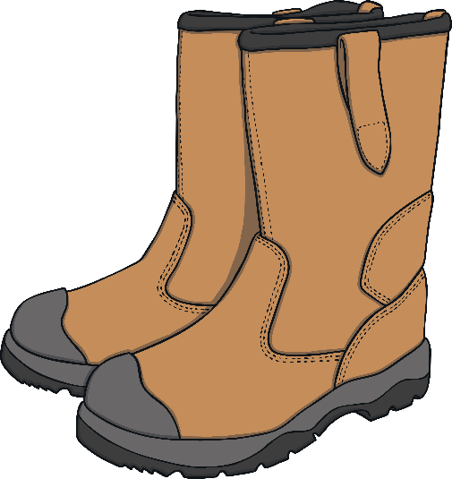
Q5
Why is it important to wear shoes that
grip in the winter?

Slide 21
Q5
Why is it important to wear shoes that
grip in the winter?
To stop you slipping next to the road.

Slide 22

Q6
What is special about reflective clothing?

Slide 23
Q6
What is special about reflective clothing?
It glows when light hits it.

Slide 24



Prayer
Dear God,
Thank you for giving us opportunities to go outside for exercise with our families.
Please keep us safe as we walk, jog, scoot and cycle.
Amen

