Slide 1

Longridge Residential
Wednesday 20th – Friday 22nd
May 2026

Slide 2
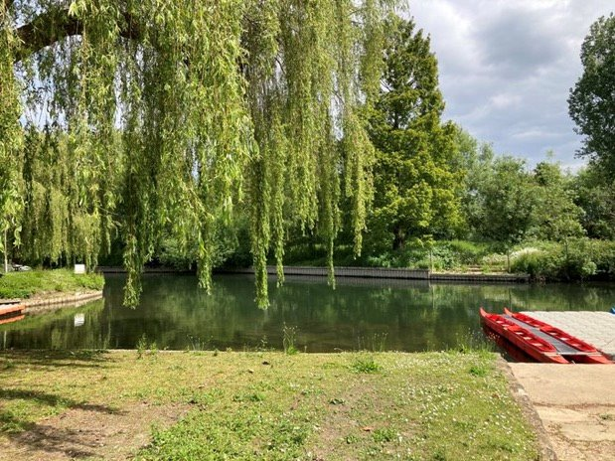
When:
20th May – 22nd May 2026
Who:
Fire Class
(current year 4 and 5 pupils)
Where:
Marlow, Buckinghamshire
PowerPoint will be uploaded.
All info will also come out in letter form when you sign up.

Slide 3
Why go?
Fantastic opportunity
Develop water skills as well as important life skills such as leadership, self-discipline, confidence and respect
Great opportunity to spend time with peers
Develop resilience
Showcase talents
Unlock new potential
Different way of learning

Slide 4
What are the activities?
Children split into groups – guaranteed at least 2 friends – staff decide
At least 1 school staff and 1 center staff per group
Rotate activities throughout the 3 days
Typical 3 days of activities include: Jacobs Ladder, Nightline, Water Orbs, Kayaking, Paddle boarding, Raft building, Trebuchet, Climbing, Team building, Bell boating

Slide 5
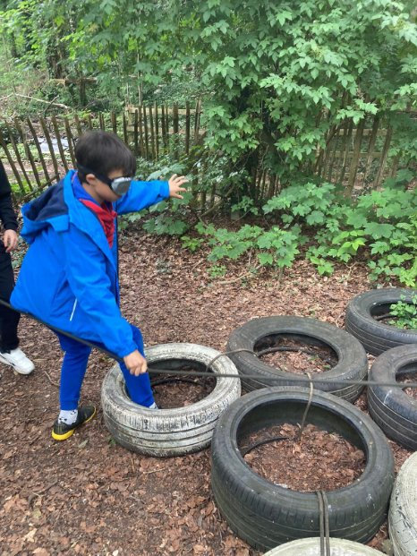
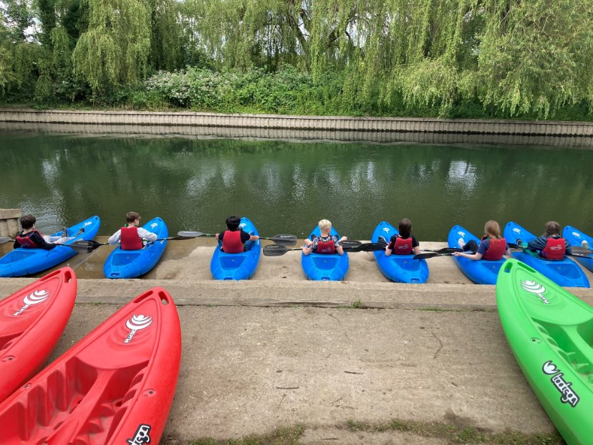

Slide 6
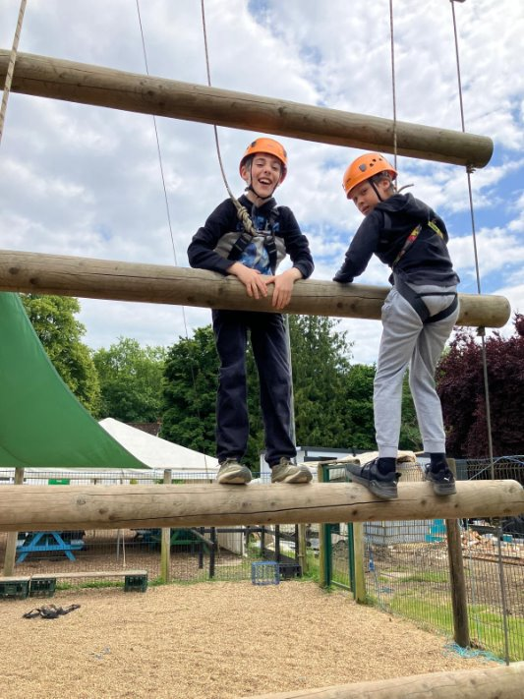
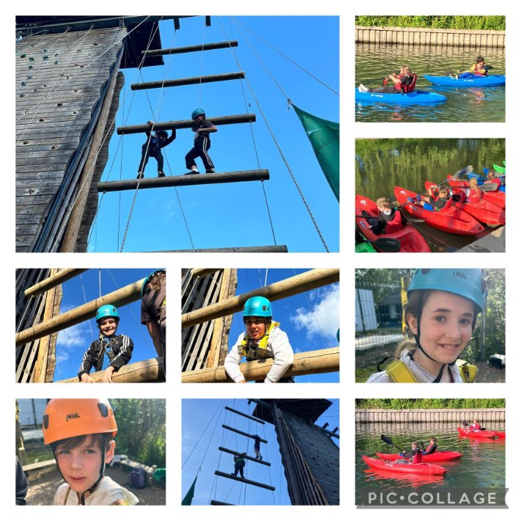
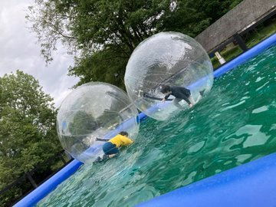

Slide 7
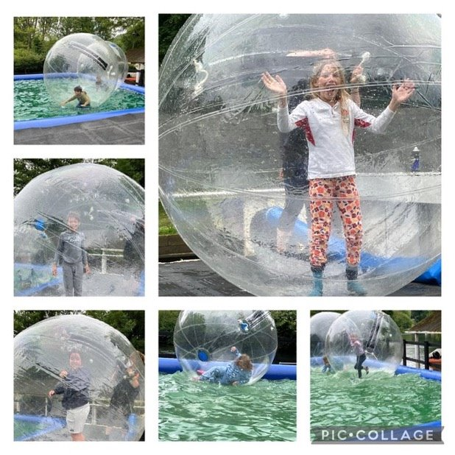
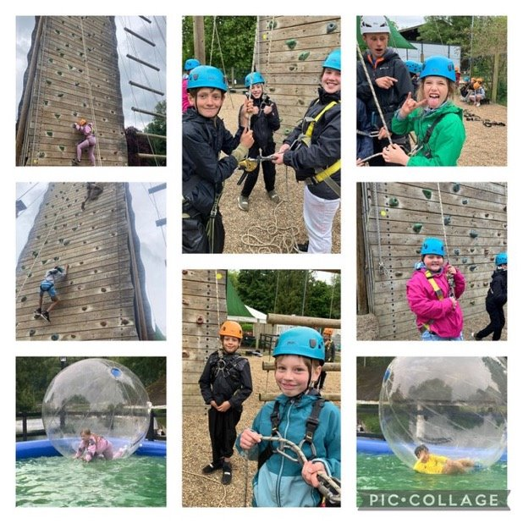

Slide 8
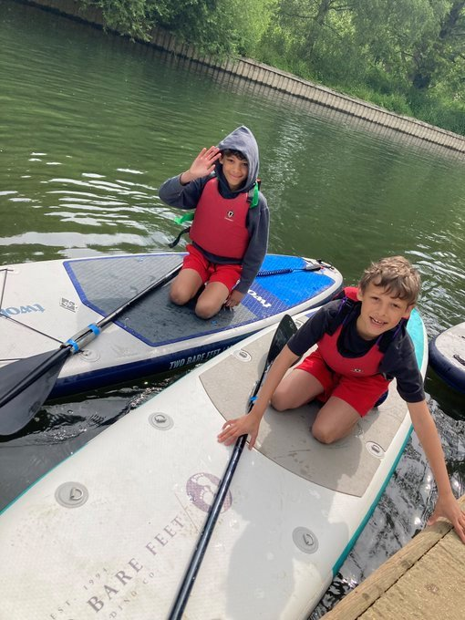
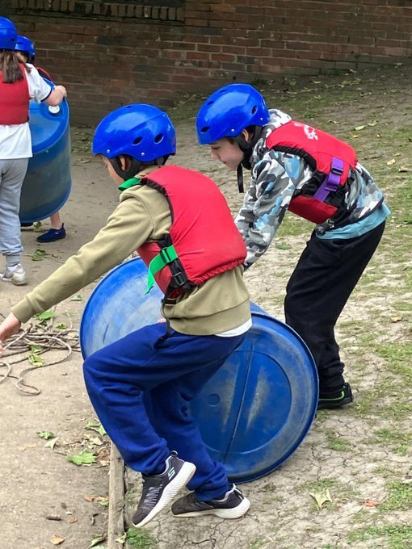
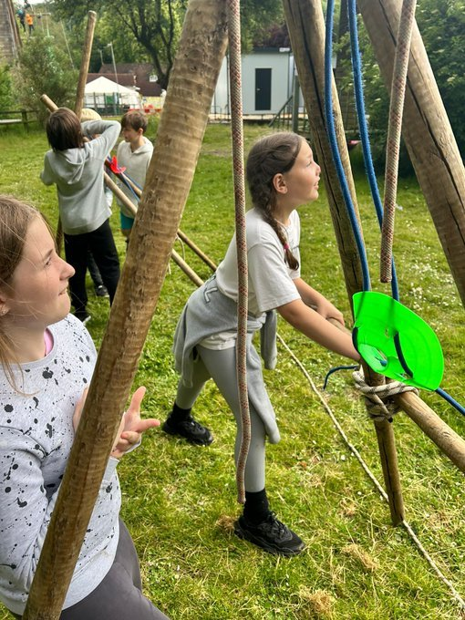

Slide 9
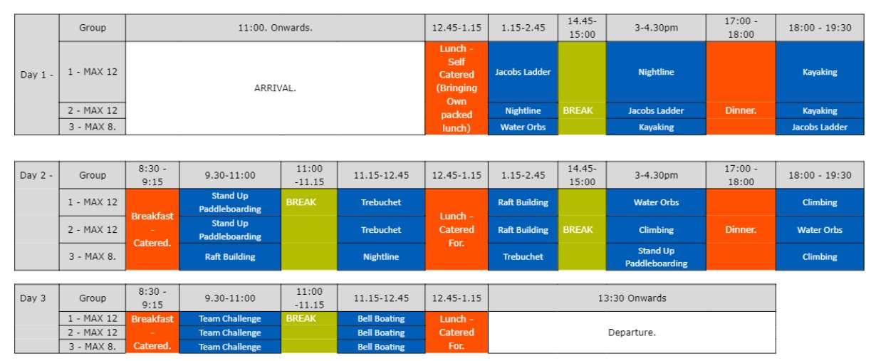
Typical Timetable

Slide 10
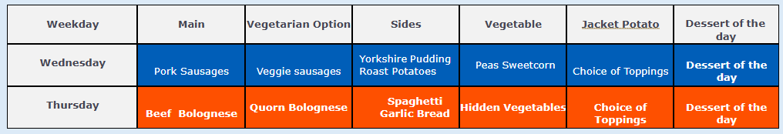
Food – menu will be confirmed nearer the time
You need to bring a packet lunch and water bottle for Wednesday. All other meals are provided. ​
Lunches choice from: Ham (H), Cheese (C), Tuna (T) or Jam(J).​
Example Menu:

Slide 11
Costings
Note:
Dec – if payments are not up to date – child withdrawn unless clear communication in place with office
Pupil Premium:
Speak to office
Can support funding for activities and travel
(parents to pay admin/food/accommodation)
Total £265.31 (approx*)
*based on type of activities and number of children
(travel, activities, accommodation and food)
May 2025 – non refundable deposit £40.31
June – Feb / March £25

Slide 12
Is my child safe?
Approved by British Canoeing and the Royal Yacht Association ​
All of our activities and training courses are fully risk-assessed and are reviewed annually. ​
Longridge is accredited by the Council for Learning Outside the Classroom (LOtC) ​
life jackets near water​
allergies / food intolerances ​
helmets / harnesses​
trained staff​
adult supervision at all times
First aid trained

Slide 13
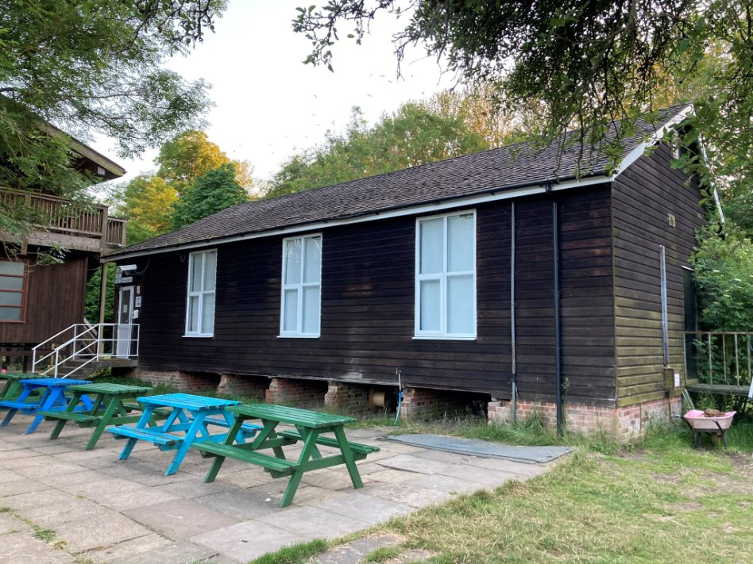
Accommodation
Rooms sleep 4 – 8 children
Same sex
Adults stay in the same building
External door locks
Children guarantee at least 1 friend – staff will decide on room allocations.

Slide 14
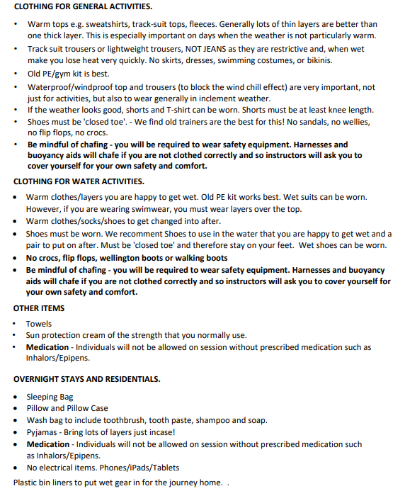
Kit List
Label everything!

Slide 15
FAQ
Can my child bring a phone?
No devices (mobile phones, tablets, air tags or smart watches) are allowed.
How can I contact my child?
No contact is allowed – we will post throughout the day online. If there was an emergency, we will contact you. If you have an emergency, contact the school and they will contact the staff member in charge.
Can my child bring games?
The children can bring cards/games to play, however they are responsible for them, and staff will not be able to look after them. ​
What are the timings of the trip?
Children will arrive at normal time on the Wednesday and be home in time for pick up on the Friday. ​
Can my child bring snacks?
No snacks are allowed – any food found will be confiscated.
What happens if my child doesn't like an activity?
If a child does not take part in an activity, they will remain with the group and watch their peers but we will encourage them to have a go.
My child is fussy / has allergies what if they don't eat?
All allergens are catered for. There is lots of choice and we usually find on school trips that children will eat as they are with their peers.

Slide 16
Any other questions?

